Slide 1

Location based Taxi Aggregator and Selector
-A Taxi Aggregator Tracking and Booking System-
Milestone Submission
May 30, 2022
Done by:
Balaji Rajagopalan
Meenakshi
Smita Garg
Suresh Natarajan
Mentor :
Mr. Rohit
IITM GL Cloud Group 5

Slide 2
Project Outline
Project Overview
Scope
Architecture
GPS AWS Cloud
Registration System
Tracking System Overview
Tracking System Implementation
Booking System Overview
Booking System Implementation
Advance Features
Future Scope
Demo
IITM GL Cloud Group 5

Slide 3
Project Overview
The Taxi Co-Op wants to build a competing solution to existing cab aggregators while keeping the power in the hands of users and drivers. We are developing a system to store real-time cab locations, respond to demands from customers based on proximity matches with available drivers. The whole solution are run on AWS.
This project is with limited scope to complete the basic requirements. Each user can make a request for a taxi at any time. They should be able to specify a taxi type preference including ‘All’.
System will respond to a user’s request with a limited list of closest taxis that match the requested taxi type. While doing the proximity matching using logic in the application code, the easier and preferable option is to use geospatial features in the database to automatically find relevant taxis.

Slide 4
Project Scope
Developing a minimal scope with initial requirements of User ad Taxi registration and Taxi booking near by users locations
Taxi and user registration modules to register relevant records in backend system
Initial area boundary creation and storage will be done vi a simulator code
Ability to ingest taxi location information and user requests in a scalable way
EC2 , Lambda and API Gateway based API, for taxi location update ingestion
API Gateway/Lambda based APIs for taking in user requests and responding to them
Scope will cover the following techno-functionalities
A large volume of customer requests (such as a rush hour)
A large migration of available taxis to some locations (rush hour, special events, etc.)
A large number of new taxis becoming available for service (shift change)
Geo-aware database choired is Document DB

Slide 5
Advanced Features
Advanced Features
Extend the project further for fulfillment. This would include
Sending notifications to the selected taxis and selection based on first response
Sending notification to the user with the selected taxi details
API for trip start and end from the taxi
Marking the taxi unavailable for other requests during the trip
Real-time visualization: The app can show a map location-based view of the supply and demand density. This can be constantly updated based on new location information.
All this information aggregated over the long-term can help plan for growth and can even be used by the city planning department for better road and traffic infrastructure planning, based on various insights and patterns. You can process and analyze the information to generate multiple important data points:
Taxi traffic density patterns based on hour and day
Common high density area locations
User demand patterns based on hour and day
Any other relevant analytics
With all the available information in real-time and long-term, you can create an innovative approach to spread taxis across the city based on the current and historical density of demand patterns. The app can send hints to drivers to shift their locations to a target area if they are in low-demand areas, and so on.

Slide 6
Intermediate Milestone Scope
An intermediate milestone will cover all basic modules such as user & taxi registration, APIs fro booking taxi, Taxi simulator code etc
Document DB is used as backend data store geo-spatial locations
User and Tai data payload structure are wlll defined
Developed an algorithm for the taxi simulator with natural-looking lat-long data generation
Lambda with python code is used to ingest per minute tai location updates to backend Ingested and stored the taxi lat-long data appropriately
Developed a minimal scope of UI in Angular framework to show the stored data visually in any browser
System has the ability to visualize a map-equivalent view of your area, showing taxi positions. As specified earlier,
Validations are not in scope
Mobile App is not in scope

Slide 7
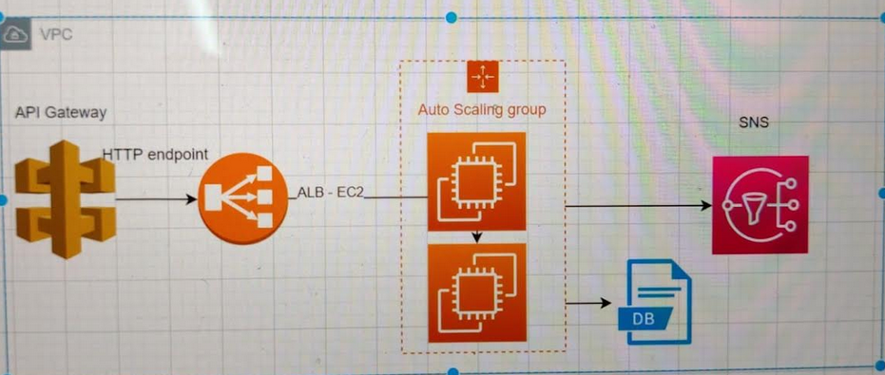
Architecture
We have chosen the below Architectural pattern, which will help others to understand the working flow of the online cab booking system. This pattern clearly showed how the User will book the cab, how to sign up, how to provide the pickup and drop locations, taxi type , etc. Make sure the user provided both pick-up and drop location.
Architecture includes various modules and services to fulfill this scope of this project

Slide 8
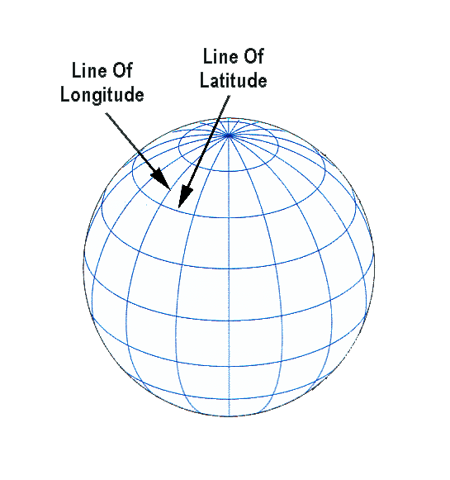
GPS System
GPS system uses geographic coordinates which is called
Latitude and longitude.
Under this system an exact location on the earth can be express as asset of number.
IITM GL Cloud Group 5

Slide 9
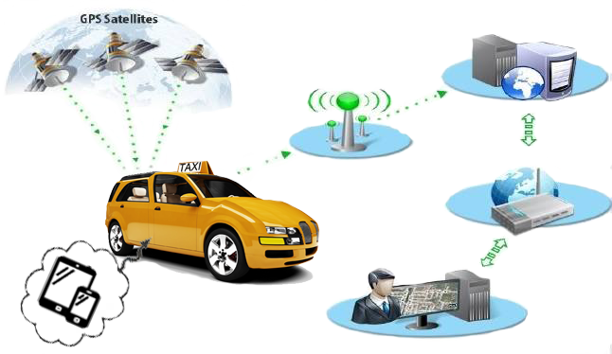
Taxi Tracking System
Taxi Tracking System consists of two components:
Web Application (Taxi office side).
Android Application (Taxi car side).
Web Application
GPRS/3G
network
Customer
Internet
GPS Receiver
IITM GL Cloud Group 5

Slide 10
Software Specification
AWS Services ( SNS, Lambda, EC2, Document DB, API Gateway, Cloud Formation, ASG )
Python Programing as Backend, Geospatial Library
Angular JS as MVC Frontend [Optional]
IITM GL Cloud Group 5

Slide 11
Use Case / Data Flow
TODO
IITM GL Cloud Group 5

Slide 12
API Interfaces
Todo
Booking API
Historical API
Discovery API
Taxi Selection API
Aggregator API
User Registration API
Taxi/Driver Registration API
IITM GL Cloud Group 5

Slide 13
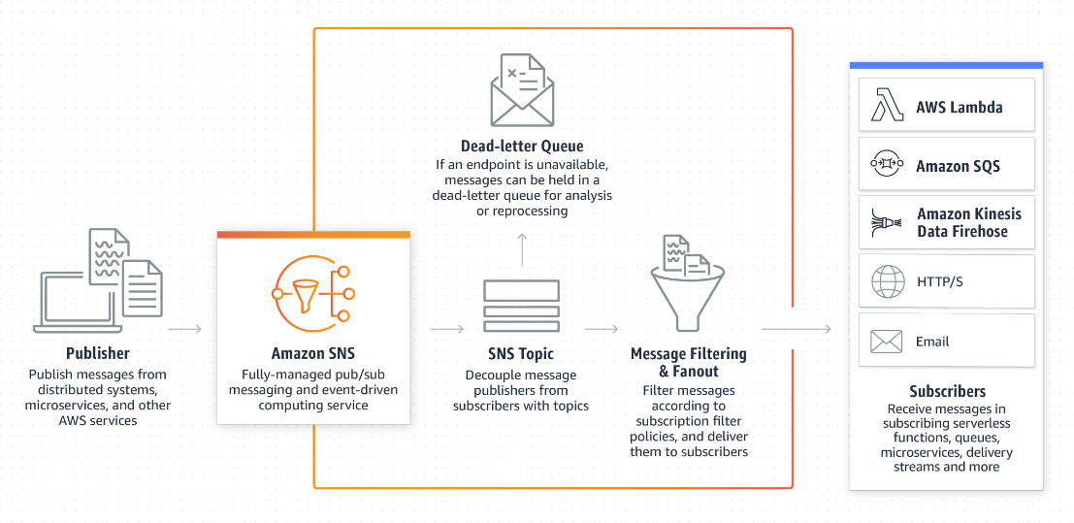
AWS SNS
Amazon Simple Notification Service (Amazon SNS) is a fully managed messaging service for both application-to-application (A2A) and application-to-person (A2P) communication.
The A2A pub/sub functionality provides topics for high-throughput, push-based, many-to-many messaging between distributed systems, microservices, and event-driven serverless applications. Using Amazon SNS topics, your publisher systems can fanout messages to a large number of subscriber systems, including Amazon SQS queues,
IITM GL Cloud Group 5

Slide 14
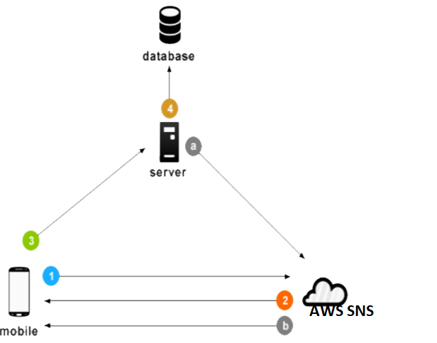
AWS SNS Push Notification
Whenever push notification is needed, our server a message to SNS server along with device registration id (which is stored earlier in the database)
SNS server will delivers that message to respected User/Mobile App

Slide 15
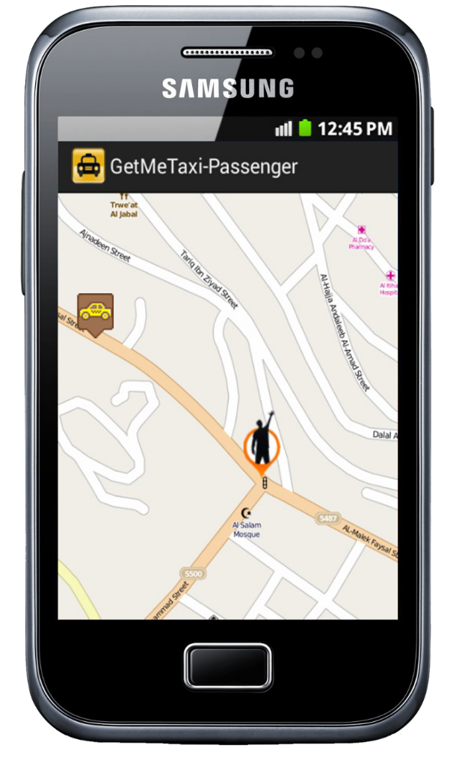
Driver/Taxi Registration Module
This application has two main function.
Registration : Register individual Taxi/Driver with shift timing
Tracking : Planned to get GPS coordinate form GPS every 10 meters and send its coordinate to the server by put the latitude and longitude of GPS and Driver ID in JSON string and send it by POST request to server.
IITM GL Cloud Group 5

Slide 16
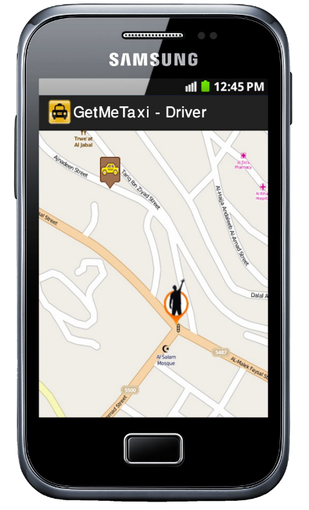
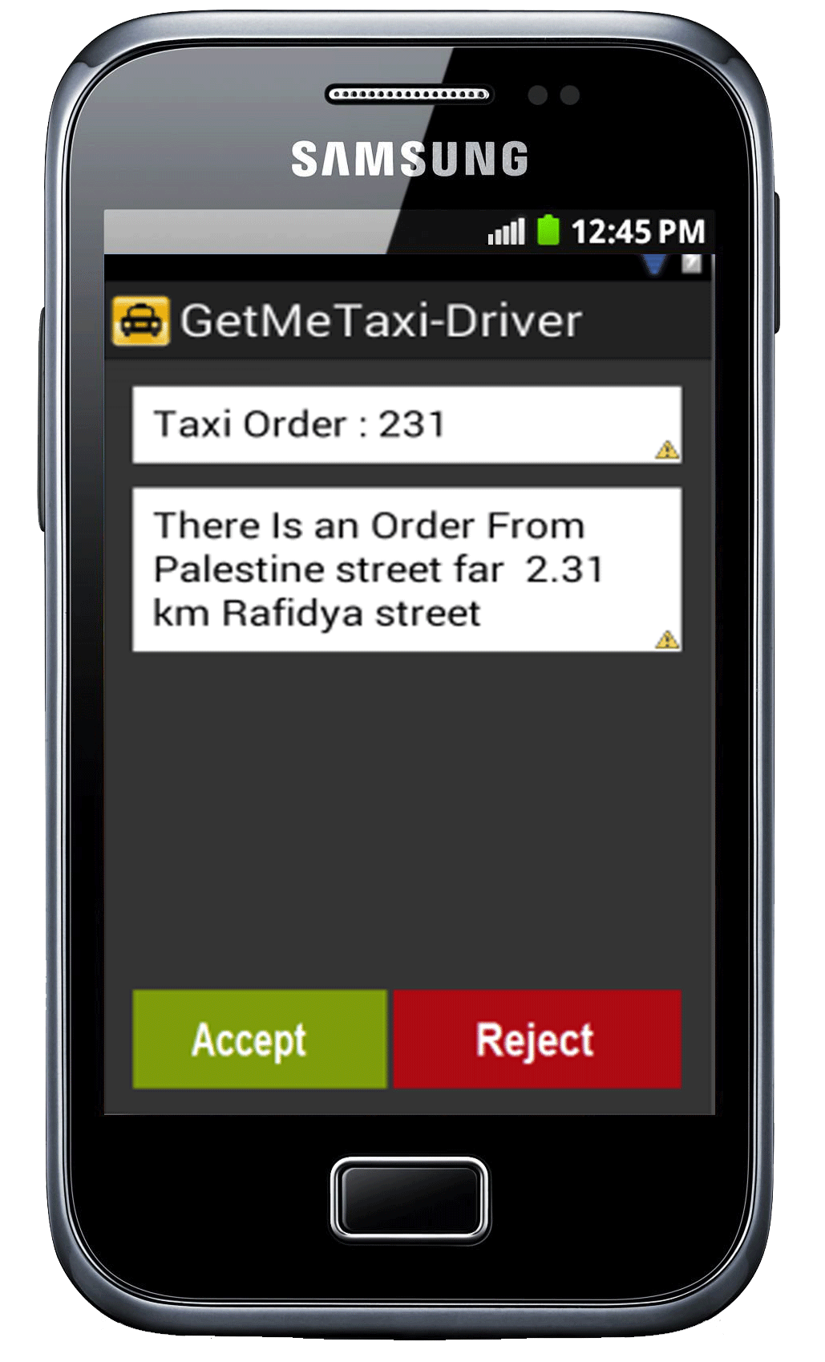
Taxi booking module
Receive booking request: This is to make application as a listener to booking request from server, if the application receive request from server the driver can be accept it or reject it in a one minuet or less, if no action from driver then the request will be kill.
So, if the driver accept request then the application open the map and set the location of the passenger and Driver on map, so the driver can easy find passenger.

Slide 17
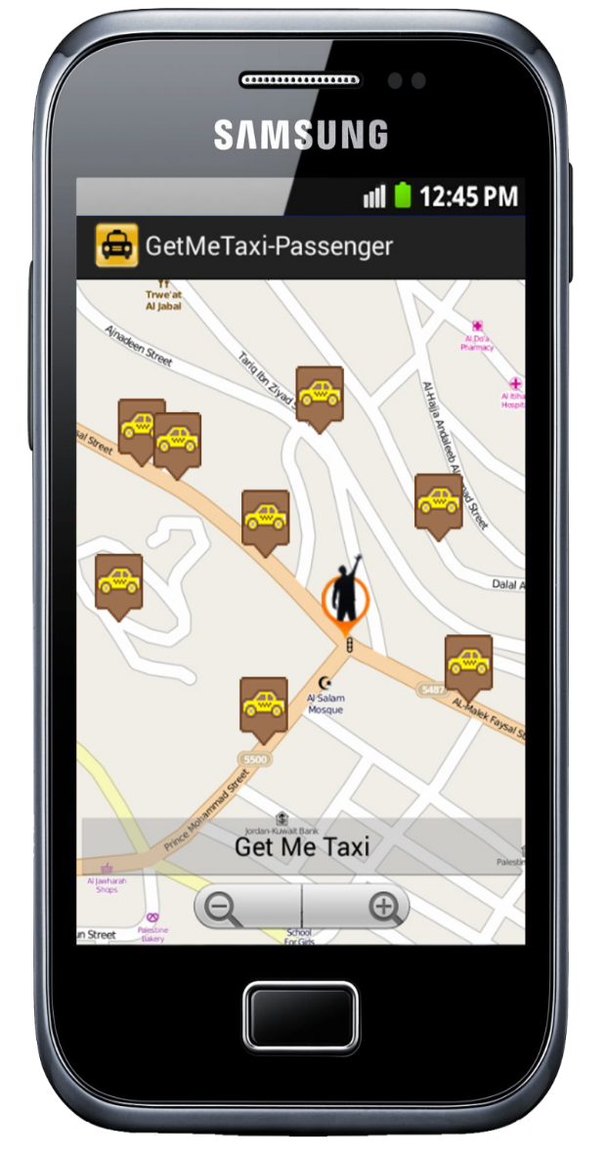
User Web App
The main function in this application is allow the user to booking taxi via Web/Mobile App [ Mobile not in scope now].
when you start application you can see all taxi near to you in the web page.
Other case when user provide source and destination locations User can select Taxi type via booking API
Currently we built a small Web GUI to demonstrate Registration and Taxi Locations
When the use did a successful booking taxi from server we can show on map the location and driver location who accept your request
IITM GL Cloud Group 5

Slide 18
User/Taxi Registration Flow
1. First register device sends user id, location id to System for registration.
2. upon successful registration server issues registration id to user web app.
3. After receiving registration id, device will send registration id to our server.
4. Our server will store registration id
in the database for later usage
5. Same flow for Taxi registration

Slide 19
Python /Lambda In Booking System
Lambda1 is Responsible for :
Handle booking requests from Passenger application.
Determine the nearest driver to the passenger by using MapQuest API web service .
Send booking Notification to Driver application by using AWS SNS
Todo

Slide 20
Future Scope
If the Useris eligible for any offers or promotions, it will apply.
Nearby cabs will be searched by the system and if any cabs are available, the system will displays the Cab/drivers details to th eUser.
Payment can be through Paytm or card or cash. The cab will drop you in the destination location and End of the Trip. This is the brief understanding will get from the architectural pattern given above
Advance UI
Validations
Mobile Apps
etc

Slide 21
Screenshots –Taxi Payload
"type":"Point",
"coordinates":[
28.61123,
77.23163
]
}
},
{
"_id":{
"$oid":"6291c2be31e685e29defcac3"
},
"name":"Pavan",
"type":"Deluxe",
"location":{
"type":"Point",
"coordinates":[
28.66542,
77.23154
]
}
}
]
[
{
"_id":{
"$oid":"6291c2be31e685e29defcac1"
},
"name":"Toofan",
"type":"Luxury",
"location":{
"type":"Point",
"coordinates":[
28.65195,
77.23149
]
}
},
{
"_id":{
"$oid":"6291c2be31e685e29defcac2"
},
"name":"Vimaan",
"type":"Basic",
"location":{

Slide 22
Data Flow Diagram
Todo

Slide 23
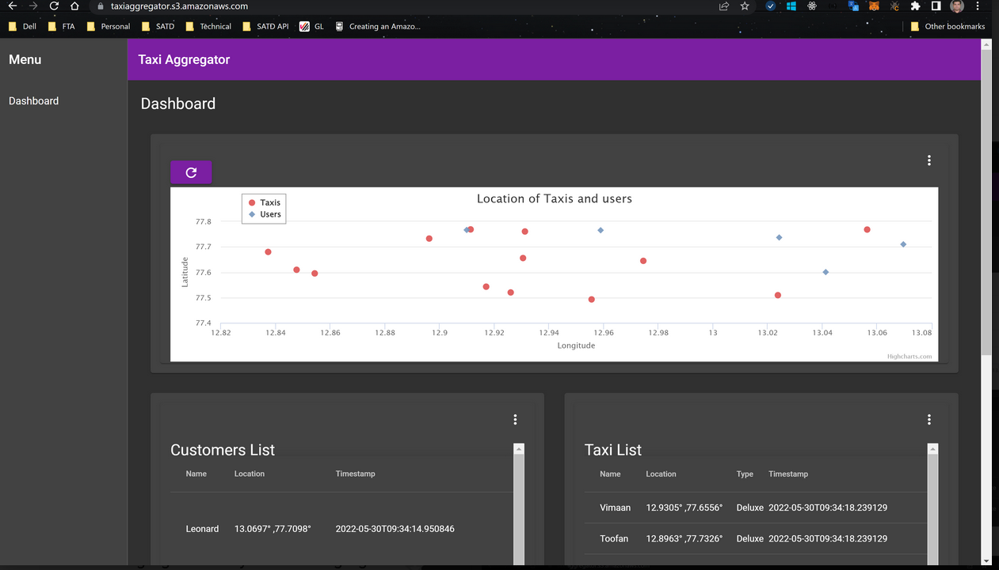
Location of customers vs taxis

Slide 24
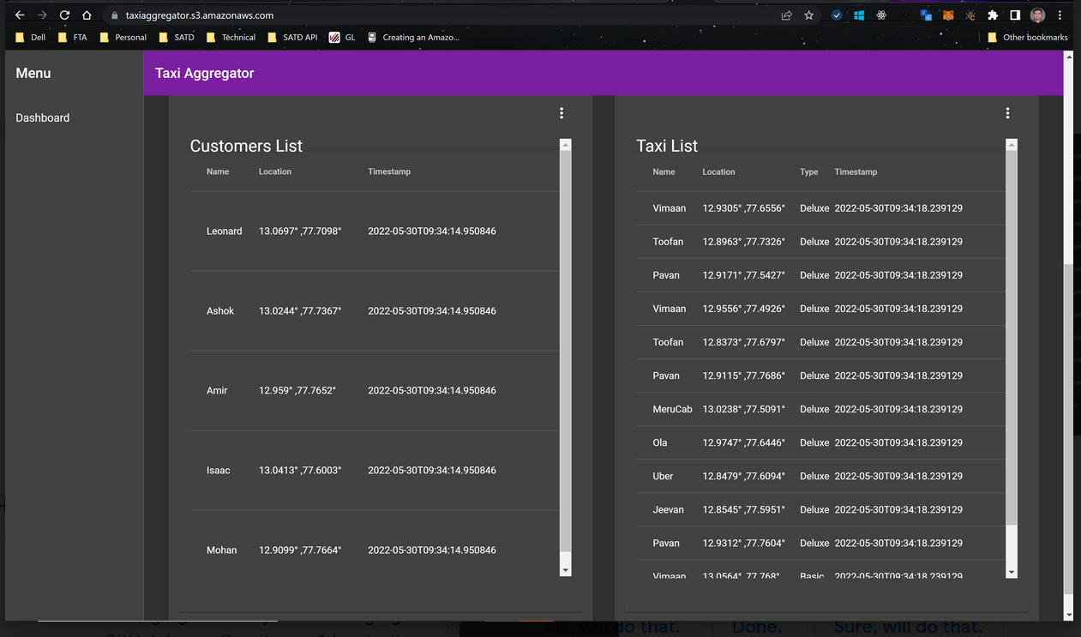
Taxi list and customer list

Slide 25
Final Demo
IITM GL Cloud Group 5

Slide 26
Thank You
IITM GL Cloud Group 5

